Slide 1
Git’n Pro with HTML/CSS

Slide 2
Admin Items

Slide 3
Where to Get Help
Practice, Practice, Practice: Work Individually or in Groups
Review In Class Material (Exercises and Slides):
Re-Watch Class Videos:
One-on-One Sessions: By Announcement through SSM
Contact Student Success: Anytime!

Slide 4
Today’s Class!

Slide 5
Today’s Objectives
Understand the importance of Git Version Control and of how to use it.
Create GitHub Repositories, push code into them, and share with class.
Students will make more HTML documents.
Students will learn to properly use basic HTML tags.

Slide 6
What / Why Git?

Slide 7
Version Control
Git Version Control: Provides a organized system for managing code for when multiple developers work on a project
at the same time.
The Benefits of Git:
Collaboration
A process for resolving conflicts in code.
Version History.
Source Code Repository

Slide 8
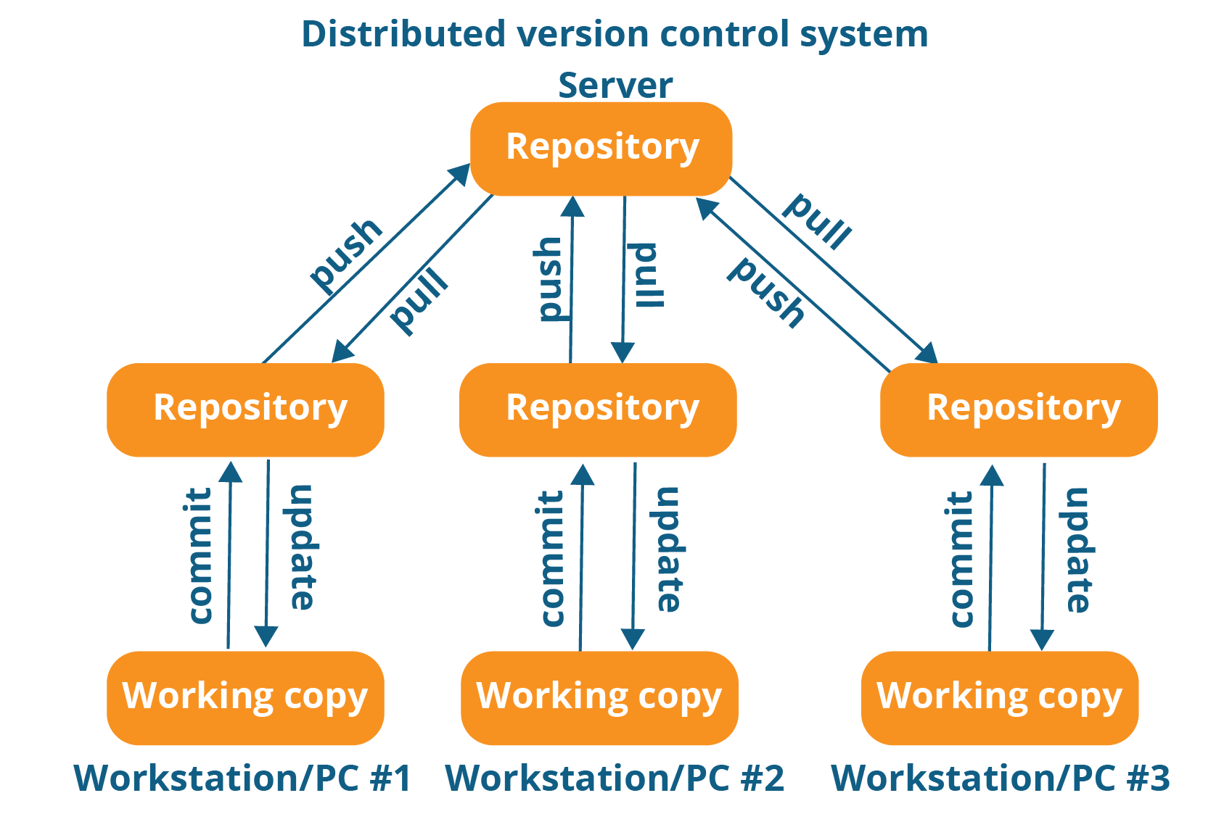
package com.sunil;

Slide 9
Quick Activity!
Suggested Time: 3 min
Turn to your neighbor, and have one of you explain to the other:
The concept of version control.
Then the other should explain:
Two of the key advantages to using a version control system.

Slide 10

So… What’s this GitHub?
GitHub is a Web-Based hosting service to store code online.
It allows developers to pull (download) code or push (upload) code to the same repository (directory).
It also allows developers to view histories of code changes and to track issues.

Slide 11


Pushing and Pulling to GitHub
1
2
3
4
GitHub Branch
Pull Code
Push Code
Pull Code
Pull Code
Push Code
Pull Code
Push Code

Slide 12
Get Started with Git

Slide 13
Basic Git Commands
At its most basic, these are the five git commands to get started:
git clone
git add
git commit
git push
git pull

Slide 14
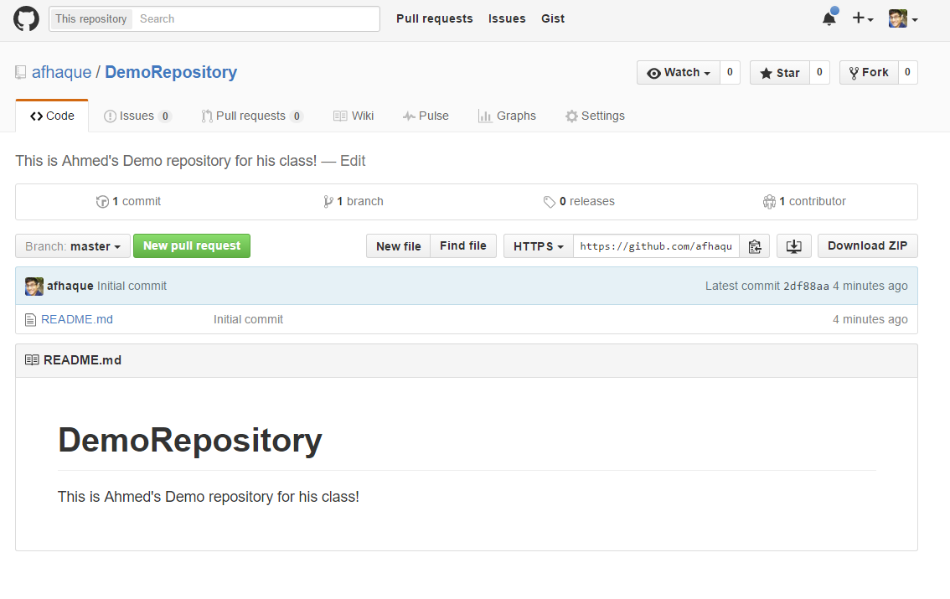
Instructor Git Demo!

Slide 15
> YOUR TURN!
Activity: Git Add, Commit, Push | Suggested Time: 20 min
Assignment:
Using GitHub and the Command Line:
Create a new public GitHub repository and name it whatever you like. Be sure to check the box for “initialize this repository with a README.”
Next, clone the repo to your local directory.
Then create an HTML file inside the local directory.
Add, Commit, and Push the code to GitHub.
Bonus:
Find a partner in class, and fork their repository to your own GitHub account. Clone this forked repository to your local directory.
Add, Commit, and Push the code back to your forked copy.
Finally, submit a pull request to send your changes to your partner’s repo.

Slide 16
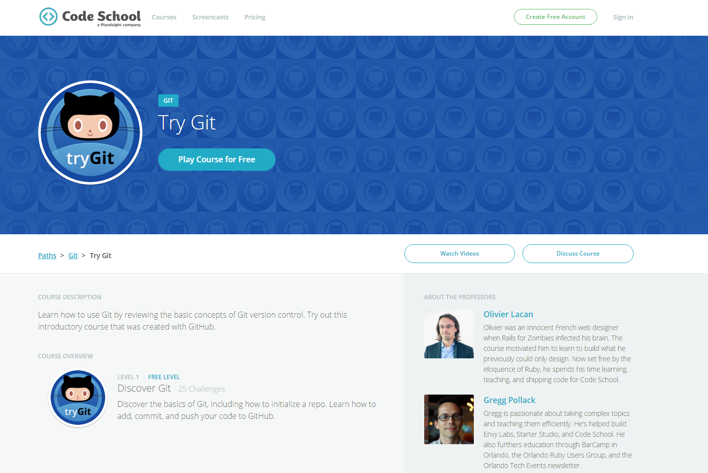
If You’re Still Lost… Here’s a (Free) Course
https://www.codeschool.com/courses/try-git

Slide 17
HTML Round 2

Slide 18
HTML Syntax (Basic)
Content
<h1>
This is Mah House
</h1>
Opening Tag
Closing Tag

Slide 19
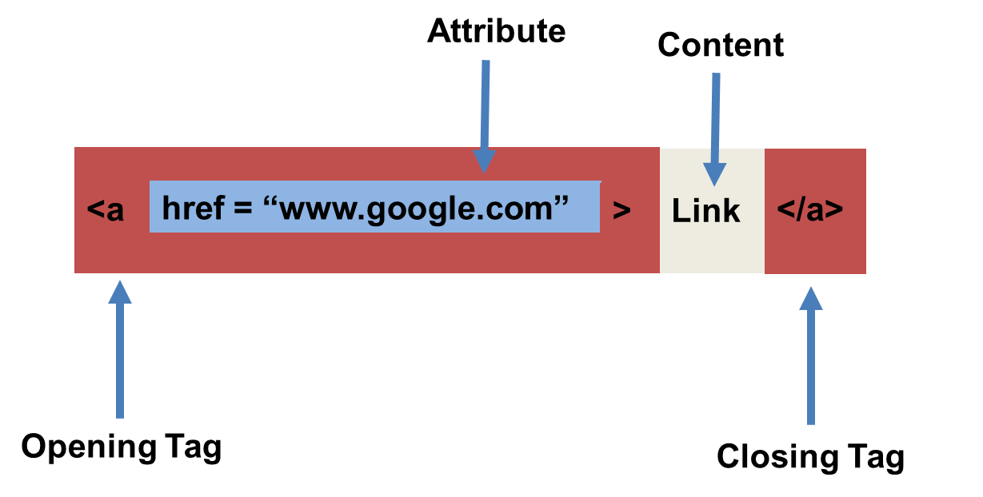
HTML Syntax (with Attribute)

Slide 20
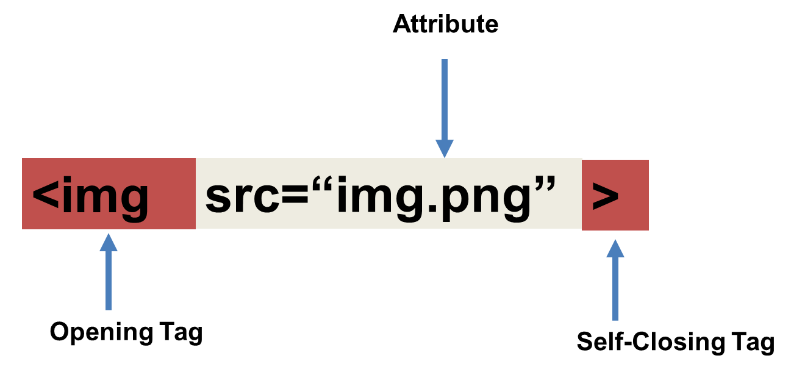
Tricky Tags (Self-Closing)

Slide 21
Important Common Tags
Headings:
<h1> </h1> - Heading 1 (Largest Heading)
<h2> </h2> - Heading 2 (Next Largest Heading)
<h3> </h3> - Heading 3
…
Containers:
<html> </html> - Wraps the entire page
<head> </head> - Wraps the header of the page
<body> </body> - Wraps the main content
<div> </div> - Logical Container ***
<p> </p> - Wraps individual Paragraphs
Others:
<strong> (bold), <em> (emphasis)
<img> (images), <a href> (links), <li> (list items) , <title> (title), <br> (line break), <table> (tables), <!-- --> (comments)

Slide 22
Less Common Tags
All HTML Tags are listed here: http://www.w3schools.com/tags/
Don’t try to memorize them! Simply refer back to documentation as needed.
Other tags:
<video> for Videos
<audio> for Audio files
<embed> for Embedded files
<code> for including computer code
<header> for headers
<nav> for navigation bars
<footer> for footers

Slide 23
HTML for Forms
Common UI (User Interface) Form Elements:
<form> - Creates a form section in HTML
<input> - Input boxes
<label> - Labels for boxes
<button> - Button
<textarea> - Large textbox

Slide 24
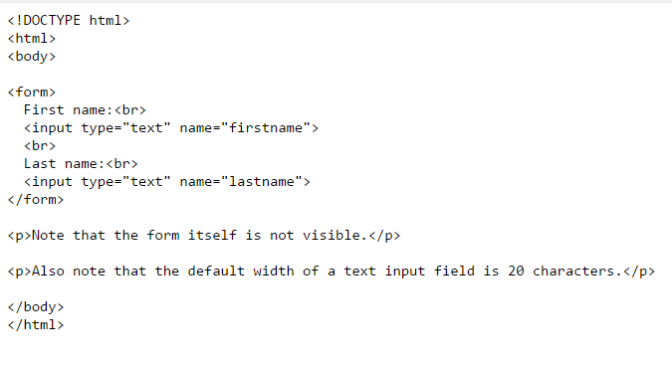
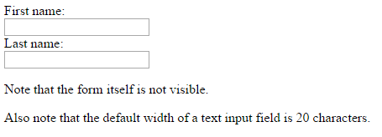
HTML for Forms

Slide 25
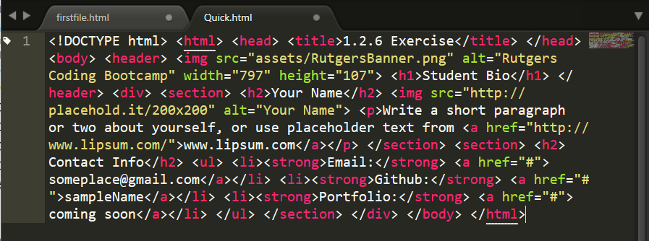
On Ugly HTML
Don’t do this… Use proper indentation and sectioning.
Readable code is easier to maintain.
Invest time to get better about this now. It will pay dividends!

Slide 26
> YOUR TURN!
Activity: 1-HTML_Git | Suggested Time: 20 min
Assignment
In this activity, you’ll create a student bio using HTML. You will then add, commit, and push your completed HTML to GitHub for the world to see.
Additional instructions, sent via Slack.

Slide 27
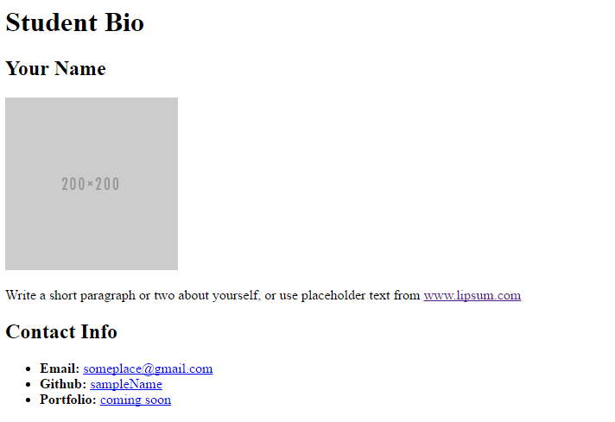
> YOUR TURN!

Slide 28
CSS Stylin’

Slide 29


HTML / CSS Definitions (*yawn* unimportant)
HTML: Hypertext Markup Language – (Content)
CSS: Cascading Style Sheets – (Appearance)
HTML/CSS are the “languages of the web.” Together they define both the content and the aesthetics of a webpage – handling everything from the layouts, colors, fonts and content placement. (JavaScript is the third – handling logic, animation, etc.)

Slide 30


HTML / CSS Analogy
HTML Alone
Like writing papers in “Notepad.”
Can only write unformatted text.
HTML / CSS
Like writing papers in Microsoft Word.
Can format text, page settings, alignment, etc. based on “highlighting” and menu options.

Slide 31
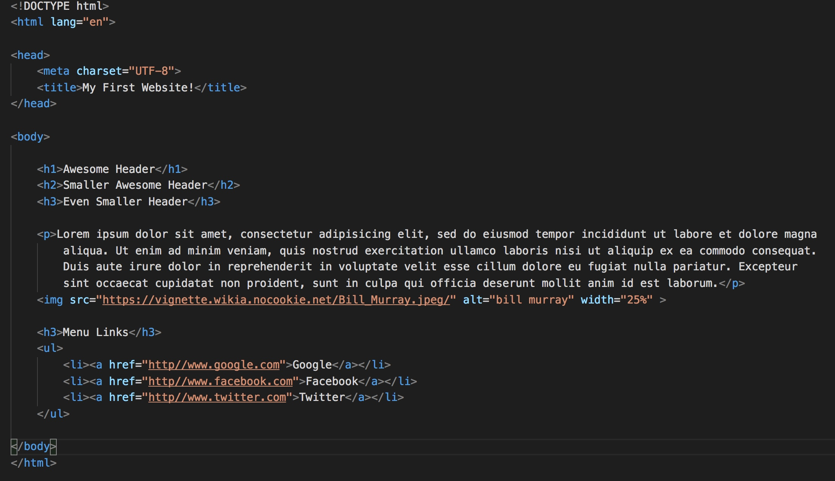
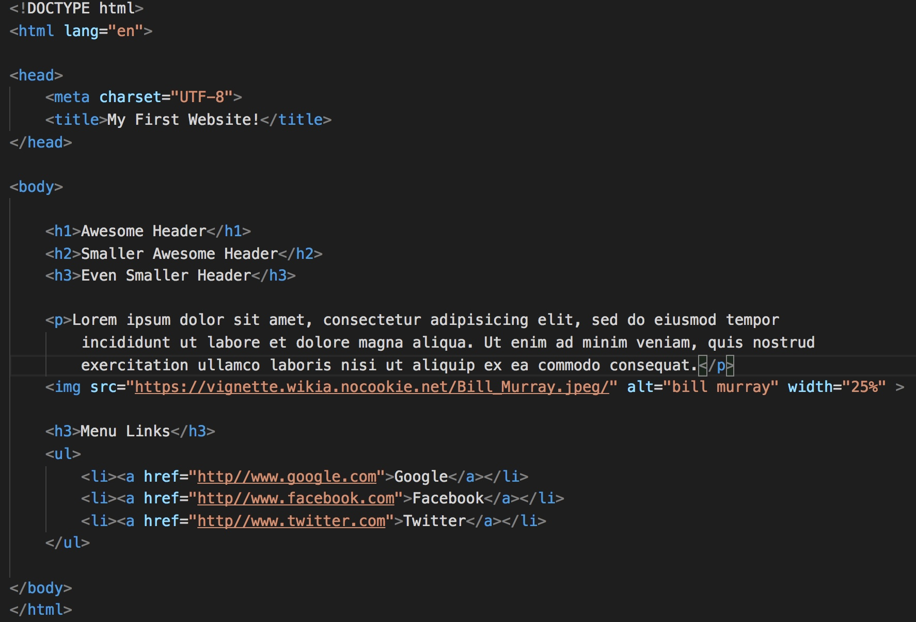
Basic HTML Page

Slide 32

Basic HTML Page - Result

Slide 33
Basic HTML Page - Result
Hella Boring…

Slide 34
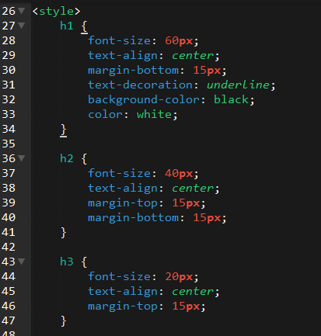
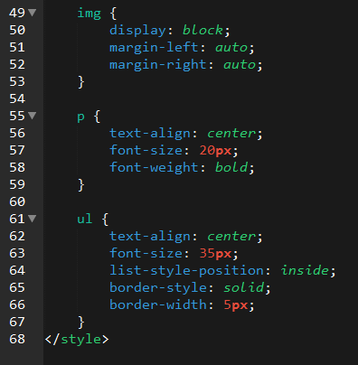
Enter CSS

Slide 35

Enter CSS - Result

Slide 36

CSS Syntax
CSS works by hooking onto selectors added into HTML using classes and identifiers.
Once hooked, we apply styles to those HTML elements using CSS.

Slide 37
CSS Example
In the below example the “Header” would be turned blue and MUCH larger because of the CSS.
We can incorporate an element’s class or ID to apply a CSS style to a particular part of the document.
Just remember to include the necessary symbol before the CSS: “.” for class, “#” for ID.
Example (HTML):
<p class=“bigBlue”>Header</p>
Example (CSS):
.bigBlue
{
font-size: 100px;
color: blue;
}

Slide 38
Key CSS Attributes
Font / Color:
color: Sets color of text.
font-size: Sets size of the font.
font-style: Sets italics.
font-weight: Sets bold.
Alignment / Spacing:
padding (top/right/bottom/left): Adds space between element and its own border.
margin (top/right/bottom/left): Adds space between element and surrounding elements.
float: Forces elements to the sides, centers, or tops.
Background:
background-color: sets background color.
background-image: sets background image.

Slide 39
Powerful Duo
Believe it or not, HTML / CSS is all you need
to develop a vivid, full-blown website.

Slide 40
INSTRUCTOR DEMO
Instructor: Demo
(quickexample_internalcss.html | 2-BasicCSS)

Slide 41
> YOUR TURN!
Activity: 3-HTML_CSS_Layout | Suggested Time: 20 min
Assignment
In this activity, you’ll upgrade your previous HTML bio-page using CSS style rules. Once you’re done, commit and push up your changes to GitHub.
We’ll send you additional instructions via Slack.

Slide 42
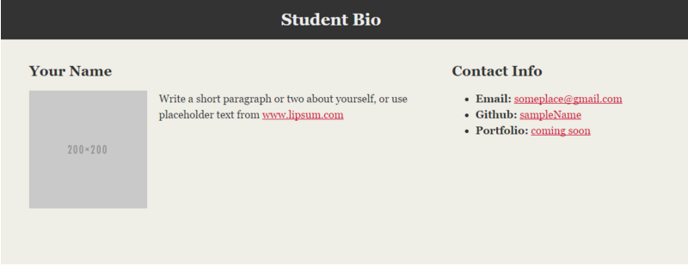
> YOUR TURN!

Slide 43
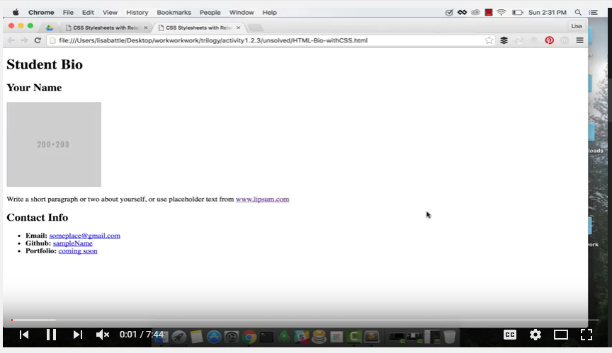
Video Walkthrough!!
https://www.youtube.com/watch?v=kMBinXTCrXI&list=PLgJ8UgkiorCnMLsUevoQRxH8t9bt7ne14&index=2

Slide 44

Still a Bit Confused?
Remember! We’ve got video guides for key activities like that last one.
If you feel like you are EVER falling behind, use those online walkthroughs to help catch back up. They are made to be easy to understand.
Still having trouble? Shoot your instructor or one of your TAs a message!
We are here to help you out in whatever way we can!

Slide 45
Recap + Questions

